Slide 1
Optimal Shape Design Using SU2
Pointwise® and SU2 Joint Workshop
Sept 29th-30th, 2014
Francisco Palacios
Aeronautics & Astronautics Department (Stanford University)

Slide 2
Introduction to Shape design
1st Optimization Attempt
2nd Optimization Attempt
Conclusions

Slide 3
Introduction to Shape design
1st Optimization Attempt
2nd Optimization Attempt
Conclusions

Slide 4
Shape Design in SU2
There are a lot of moving parts in the design loop…
However, SU2 provides everything you need for design. Futhermore, it is possible to configure each module within a single config file (.cfg)
With everything in place, call shape_optimization.py
Python automates the shape design loop for you
$ shape_optimization.py –f LM-1021.cfg –n 96
‘-f’ specifies config filename
‘-n’ specifies number of procs for parallel jobs

Slide 5
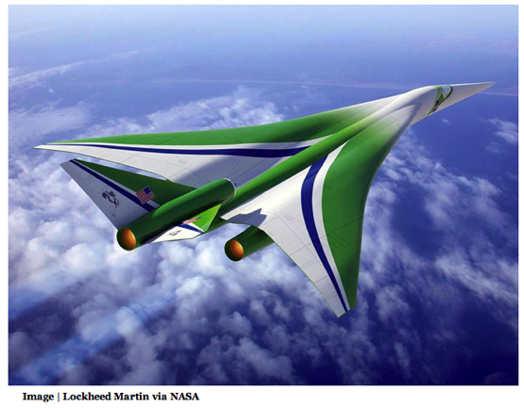
In this presentation…
We will focus on the redesign of a supersonic aircraft:
Starting with a basic setting, we will run a quick optimization and then propose some changes (man in the loop) to improve the results.
Shape design has some moving tools and parameters that should be adjusted. We will also discuss that topic.
Supersonic low-boom design is not new! What has changed? computational resources, turbulence modelling, adjoint based design tools, better understanding of the propagation…
The goal: to enable routine use of high-fidelity tools in the multi-disciplinary design of complete low-boom configurations.
65-70 PLdB
Image | Lockheed Martin via NASA webpage

Slide 6
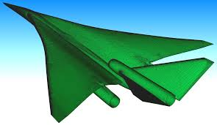
Shape Design in SU2
Python orchestrates the automatic shape design loop. Can easily adapt a config file from an existing case (check TestCases folder).
Design optimization objective: Decrease the pitching moment by 25% (trim the aircraft by changing the wing shape).
In our first attempt, we are going to propose the following shape optimization problem:
Reduce drag (if possible)
Maintain 95% of the original lift.
Maintain 90% of the original maximum thicknesses at 2 outboard wing sections
It can be difficult to reduce drag
given a good starting configuration
based on supersonic theory.
So, what do you need to know in
order to set up your own shape
design problems?

Slide 7
Optimization Problem
From the optimizer
flow solution
adjoint solution
Baseline surface mesh
design parameters
cost/constraint functions
FFD Technique
To the optimizer
Mesh deformation
Gradient module
Baseline volumetric mesh
Direct solver
Adjoint solver
Input file
Signature extraction
Obj. Func. calculation

Slide 8
Optimization Problem
Define your optimization problem in the config file
Choose an objective, constraints (including geometric), and specify your design variables
Full specifications can be found in config_template.cfg
Scaling factor helps optimizer take appropriate first step
% Optimization objective function with scaling factor
% ex= Objective * Scale
OPT_OBJECTIVE= DRAG * 0.01
%
% Optimization constraint functions with scaling factors, separated by semicolons
% ex= (Objective = Value ) * Scale, use '>','<','='
OPT_CONSTRAINT= (MOMENT_Y < 0.0135919515) * 0.01; (LIFT > 0.13212308464) * 0.01; (MAX_THICKNESS_SEC1 > 0.0035208432) * 0.01; (MAX_THICKNESS_SEC4 > 0.0013014216) * 0.01; (MAX_THICKNESS_SEC5 > 0.00052060608) * 0.01

Slide 9
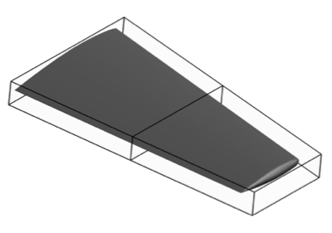
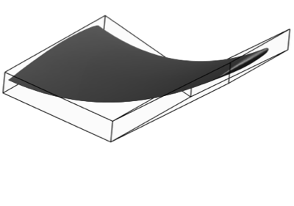
Geometry Parameterization
Parameterize by a Free-Form Deformation (FFD) approach.
Technique has origins in the computer graphics industry.
Encapsulate geometry in a bounding box and create a mapping between the FFD control points and the mesh surface nodes.
FFD control points become the design variables (DVs) with the surface inheriting a smooth deformation.
FFD variables are now available in both 2D & 3D with SU2 V3.2.2

Slide 10
Geometry Parameterization
Set up FFD boxes at bottom of the SU2 native mesh file.
The new script for Pointwise can generate this information.
Initialize the mapping for the FFD box by running SU2_MDC once with option DV_KIND= FFD_SETTING.
After completion, a new copy of the mesh with all FFD information is written to disk.
Use this new mesh for shape optimization.
FFD box specification for our LM 1021 problem
FFD_NBOX= 1
FFD_NLEVEL= 1
FFD_TAG= WING
FFD_LEVEL= 0
FFD_DEGREE_I= 10
FFD_DEGREE_J= 12
FFD_DEGREE_K= 1
FFD_PARENTS= 0
FFD_CHILDREN= 0
FFD_CORNER_POINTS= 8
0.502544 -0.044427 0.0488
0.352456 -0.044427 0.0488
0.503809 -0.107234 0.06271
0.53585 -0.107234 0.06271
0.502544 -0.044427 0.06534
0.352456 -0.044427 0.06534
0.503809 -0.107234 0.06828
0.53585 -0.107234 0.06828
FFD_CONTROL_POINTS= 0
FFD_SURFACE_POINTS= 0

Slide 11
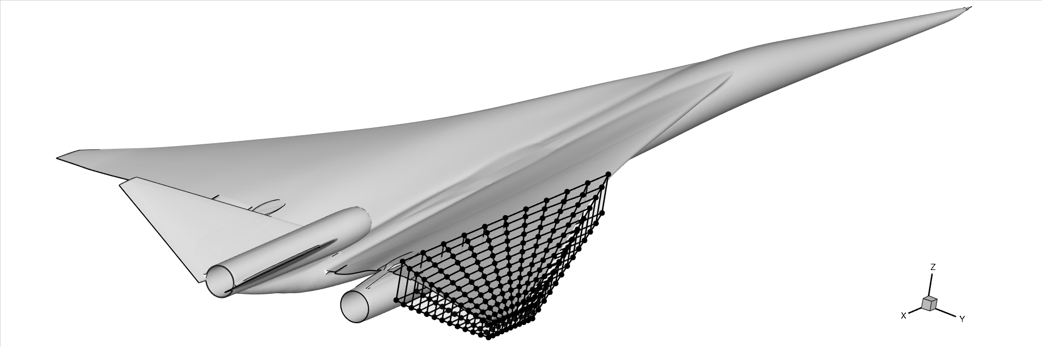
Geometry Parameterization
FFD box for redesigning the Lockheed Martin 1021 configuration
264 FFD Control Point Variables
(z direction)
DEFINITION_DV= ( 7, 1.0 | aircraft | WING, 0, 2, 0, 0.0, 0.0, 1.0 ); ( 7, 1.0 | aircraft | WING, 1, 2, 0, 0.0, 0.0, 1.0 ); ( 7, 1.0 | aircraft | WING, 2, 2, 0, 0.0, 0.0, 1.0 ); ( 7, 1.0 | aircraft | WING, 3, 2, 0, 0.0, 0.0, 1.0 ); ( 7, 1.0 | aircraft | WING, 4, 2, 0, 0.0, 0.0, 1.0 ); ( 7, 1.0 | aircraft | WING, 5, 2, 0, 0.0, 0.0, 1.0 ); ( 7, 1.0 | aircraft | WING, 6, 2, 0, 0.0, 0.0, 1.0 ); ( 7, 1.0 | aircraft | WING, 7, 2, 0, 0.0, 0.0, 1.0 ); ...

Slide 12
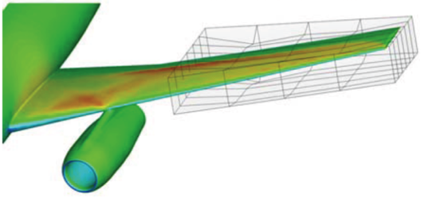
Flow & Adjoint Problem Setup
Find such that
set of flow variables
set of design variables
Governing equation of the fluid:
Functional to minimize: .
where
Adjoint approach. What is the adjoint equation?
Choosing to satisfy the adjoint equation:
Easy to formulate, complex to solve robustly when dealing with turbulence, shocks, geometries with singularities, surface formulation.

Slide 13
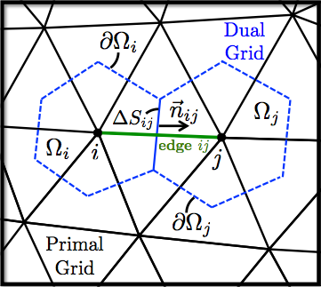
Flow & Adjoint Problem Setup
Unstructured meshes with median-dual control volumes (vertex-based).
Finite Volume Method with second-order schemes.
For the supersonic problem, we’ll focus on JST spatial integration (centered) with implicit time integration.
Similar schemes for integrating the flow and adjoint equations (adjoint scheme is non-conservative).

Slide 14
Flow & Adjoint Problem Setup
% - FLOW NUMERICAL METHOD DEFINITION - %
%
% Convective numerical method (JST, LAX-FRIEDRICH, CUSP, ROE, AUSM, HLLC, TURKEL_PREC, MSW)
CONV_NUM_METHOD_FLOW= JST
%
% 1st, 2nd and 4th order artificial dissipation coefficients
AD_COEFF_FLOW= ( 0.15, 0.5, 0.02 )
%
% Time discretization (RUNGE-KUTTA_EXPLICIT, EULER_IMPLICIT, EULER_EXPLICIT)
TIME_DISCRE_FLOW= EULER_IMPLICIT
% - ADJOINT-FLOW NUMERICAL METHOD DEFINITION -%
%
% Convective numerical method (JST, LAX-FRIEDRICH, ROE)
CONV_NUM_METHOD_ADJFLOW= JST
%
% 1st, 2nd, and 4th order artificial dissipation coefficients
AD_COEFF_ADJFLOW= ( 0.15, 0.5, 0.05 )
%
% Time discretization (RUNGE-KUTTA_EXPLICIT, EULER_IMPLICIT)
TIME_DISCRE_ADJFLOW= EULER_IMPLICIT
%
% Reduction factor of the CFL coefficient in the adjoint problem
CFL_REDUCTION_ADJFLOW= 0.25
%
% Limit value for the adjoint variable
LIMIT_ADJFLOW= 1E6
Unstructured meshes with median-dual control volumes (vertex-based).
Finite Volume Method with second-order schemes.
For the supersonic problem, we’ll focus on JST spatial integration (centered) with implicit time integration.
Similar schemes for integrating the flow and adjoint equations (adjoint scheme is non-conservative).

Slide 15
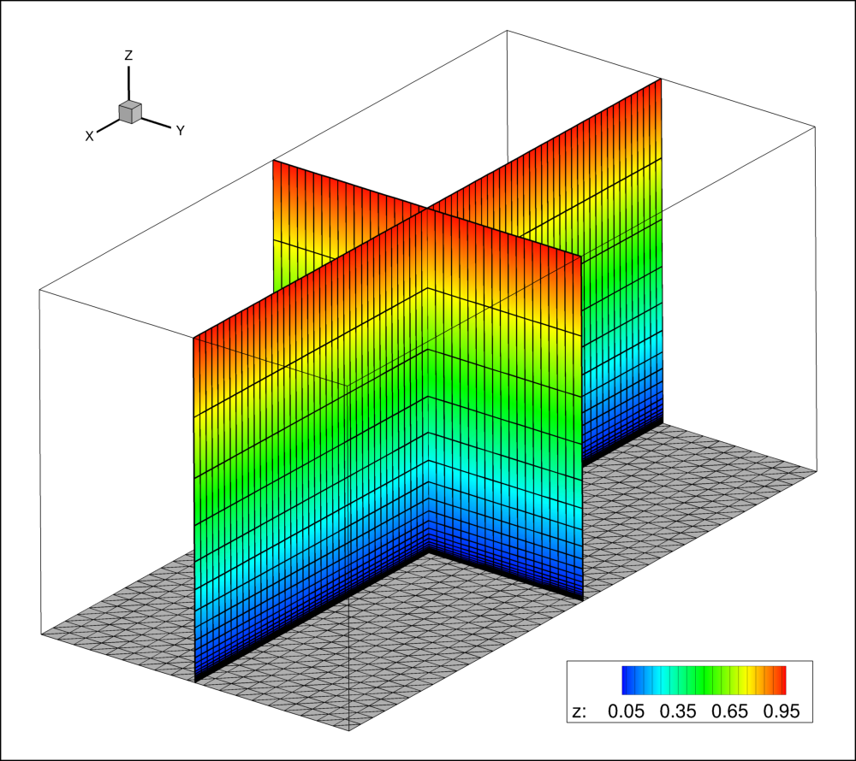
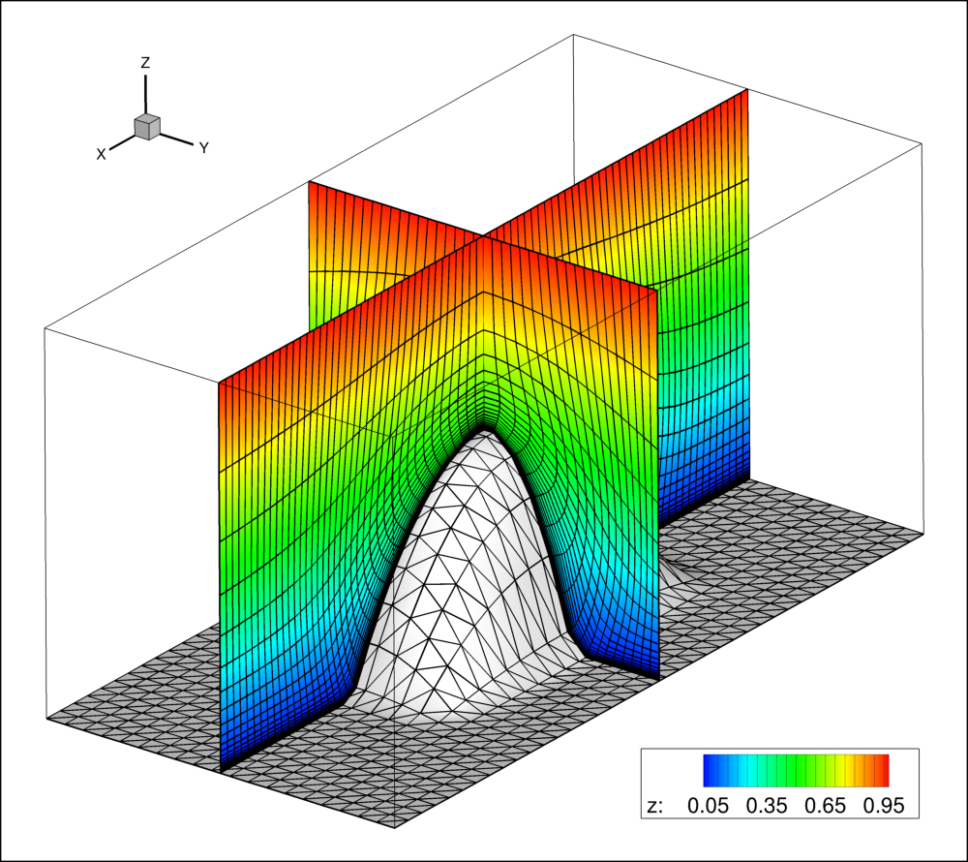
Mesh Deformation
Need robust mesh deformation technique…
Treat the mesh as an elastic solid with non-uniform stiffness
Solve the linear elasticity equations on the mesh for the nodal displacements using the movement of the boundaries as input

Slide 16
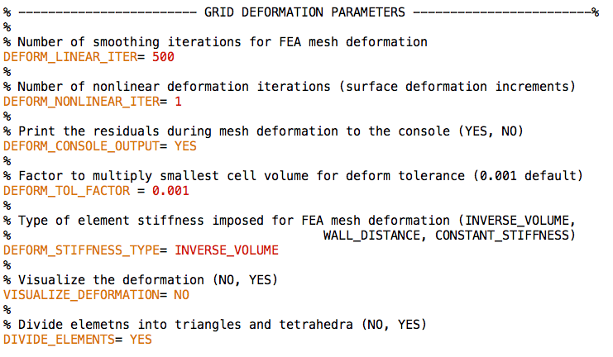
Mesh Deformation
Controls type of cell stiffness. Smaller cells or those near walls will be more rigid under deformation (preserves mesh quality).

Slide 17
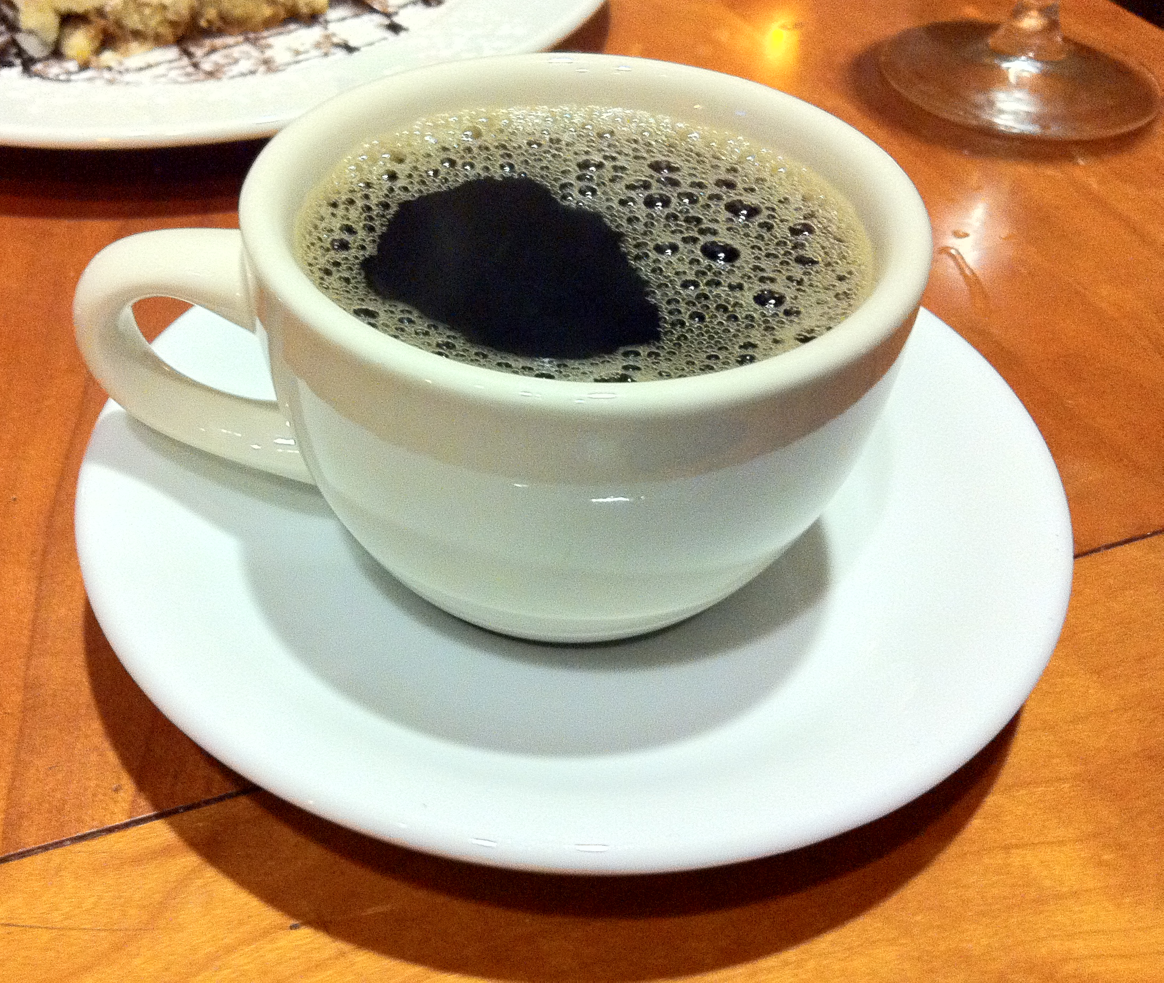
Shape Design in SU2
$ shape_optimization.py –f LM-1021.cfg –n 96

Slide 18
Introduction to Shape design
1st Optimization Attempt
2nd Optimization Attempt
Conclusions

Slide 19
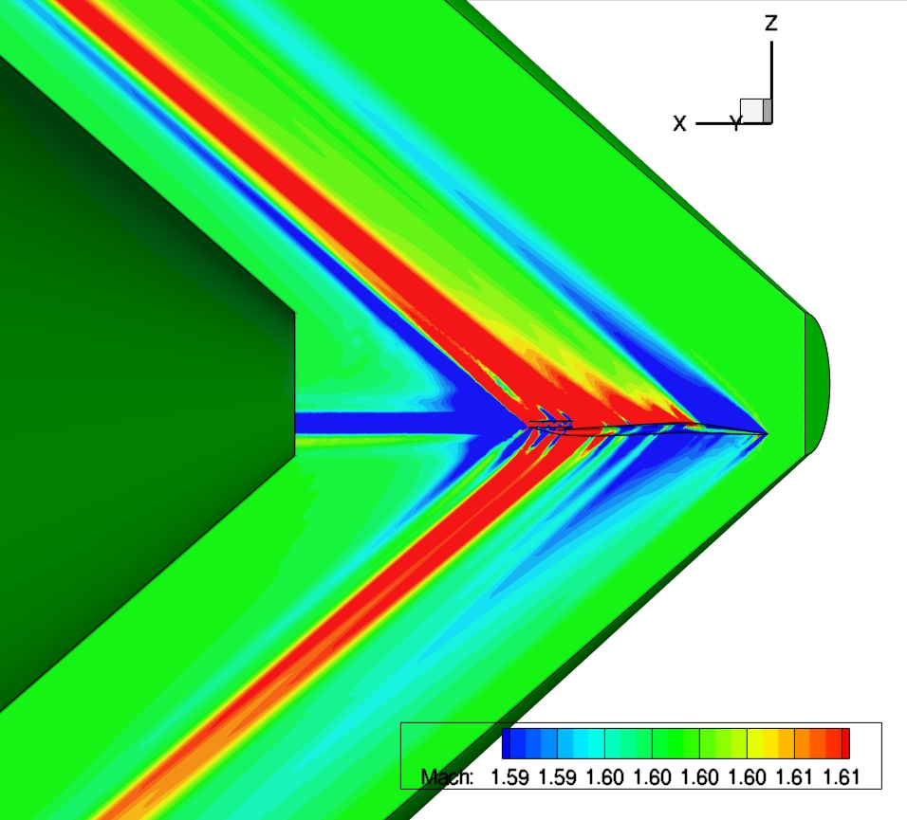
Optimization Results
Shock-aligned hex cells can help maintain accuracy and reduce cost for boom predictions when extracting off-body pressure signatures.

Slide 20
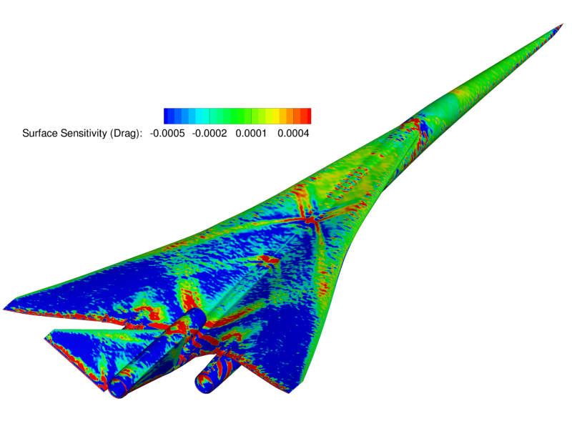
Optimization Results
The Continuous Adjoint in SU2 provides surface sensitivities: a measure of the change in the objective function at each node due to small perturbations in the local normal direction.

Slide 21
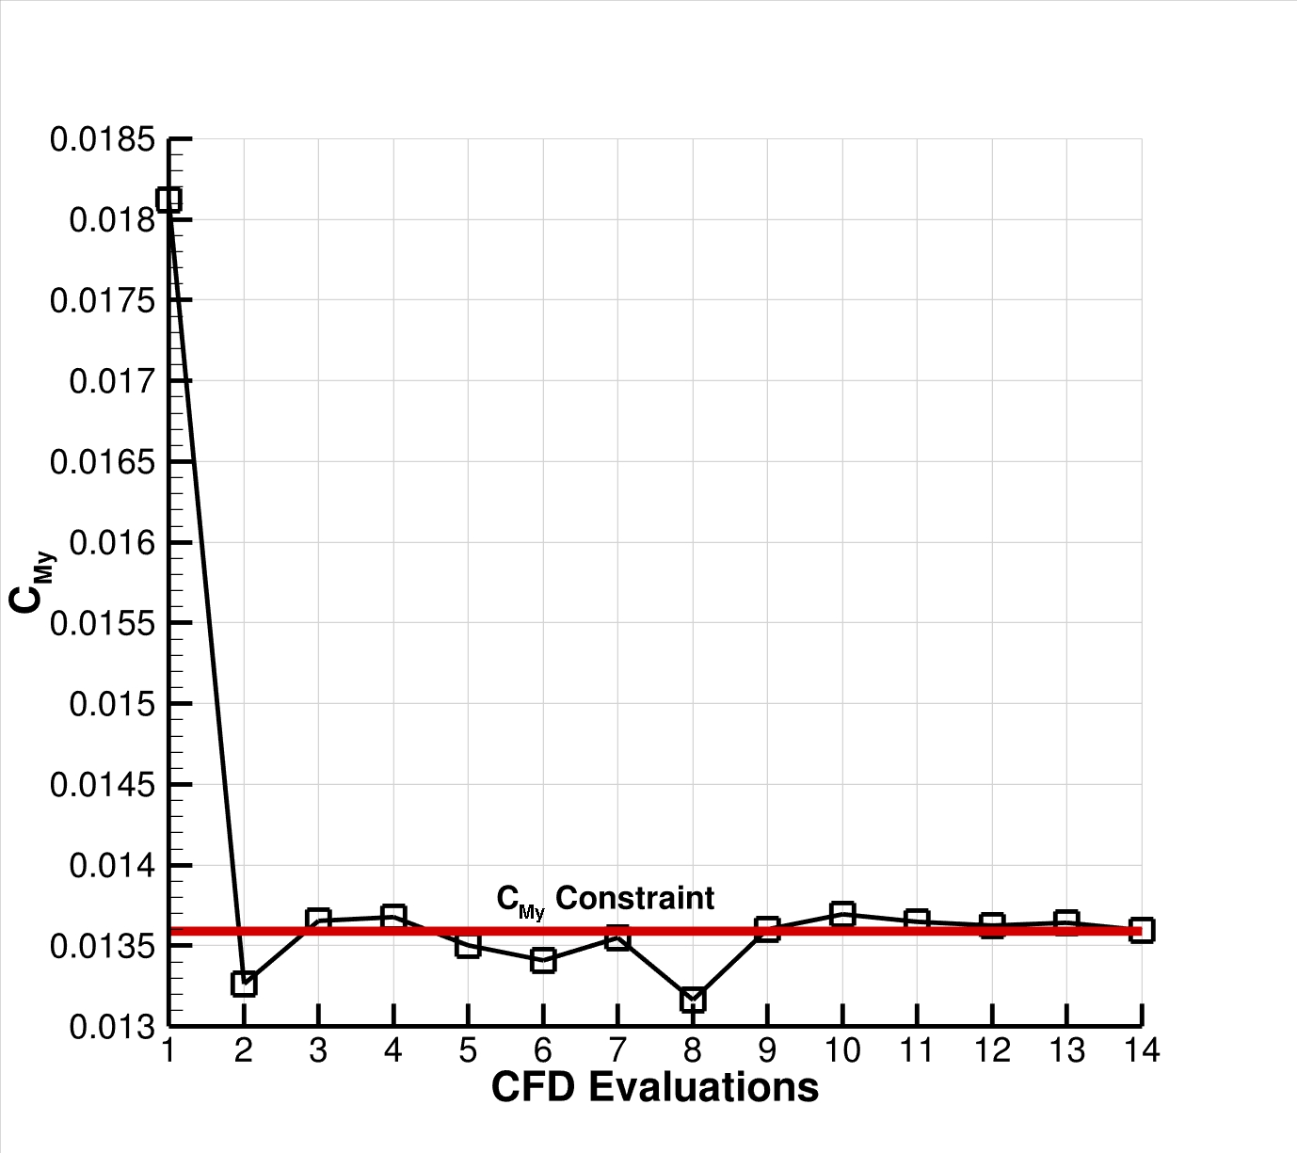
Pitching Moment Constraint
LM-1021 optimization:
Objective: Reduce C_{My} from 0.018 to 0.0135.
Maintaining C_{L}.
Without affecting C_{D}.
Constraining the minimum value of the maximum thickness at 2 outboard sections.
Using 263 design variables.
The main objective has been satisfied
✔

Slide 22
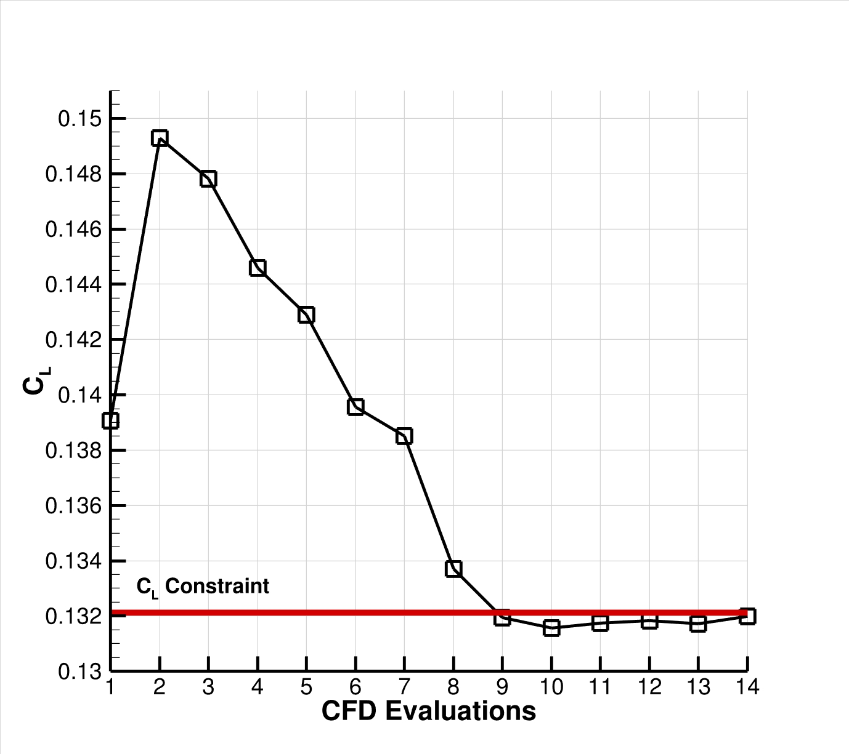
Lift constraint
The C_{L} is acceptable
✔

Slide 23
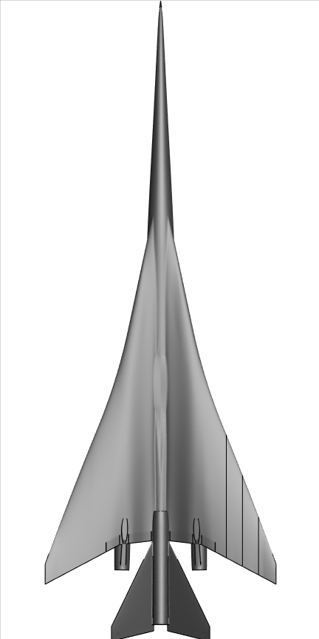
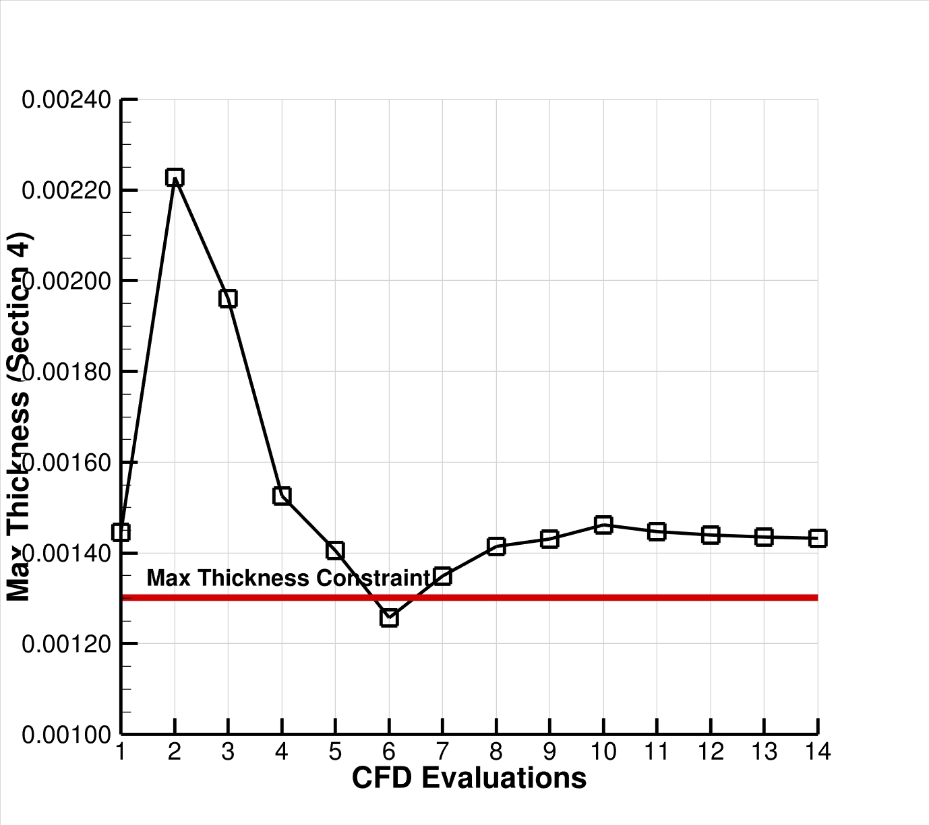
Maximum thickness (y=0.08675m) constraint
✔

Slide 24
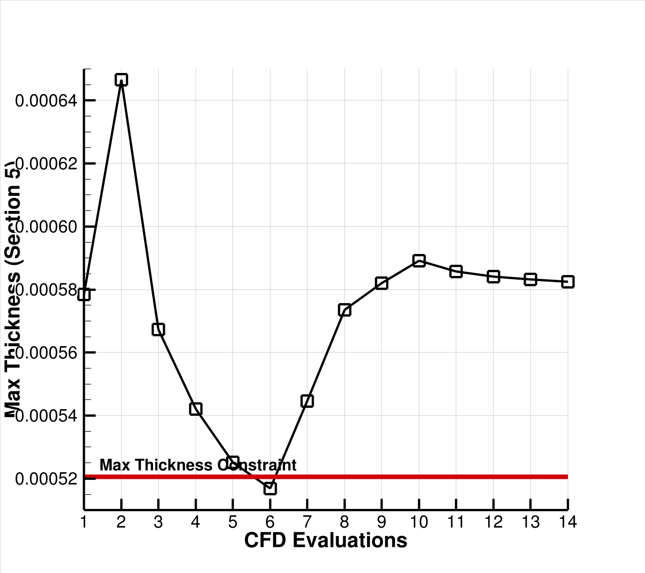
Maximum thickness (y=0.10100m) constraint
✔

Slide 25
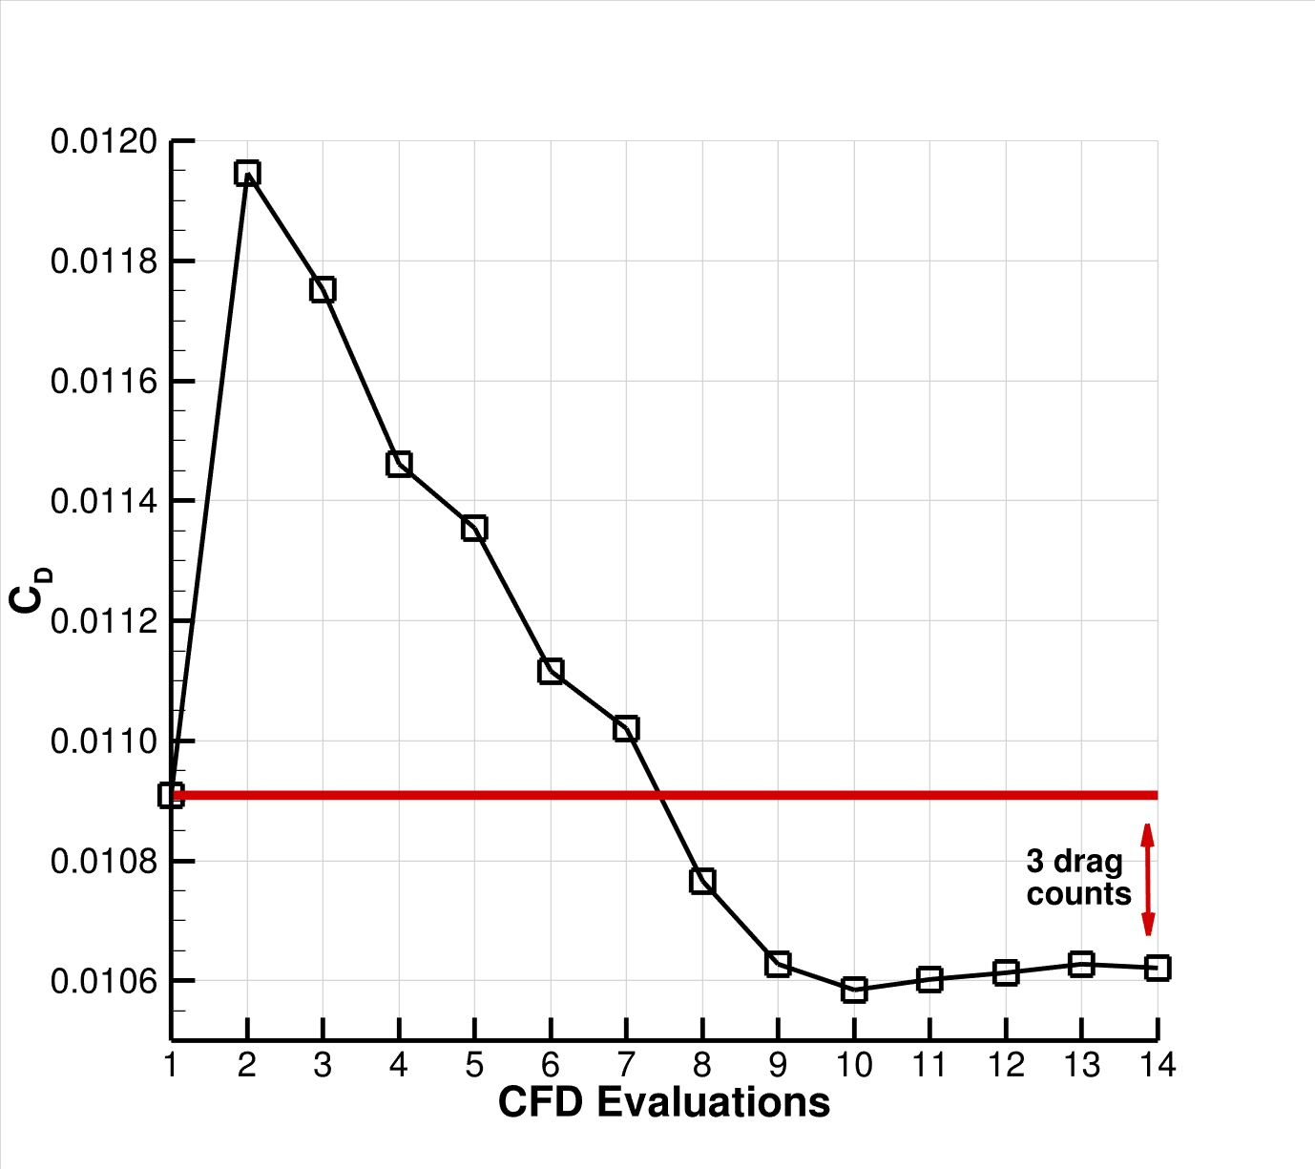
Drag objective function (min)
Small decrease in C_{D}
✔

Slide 26
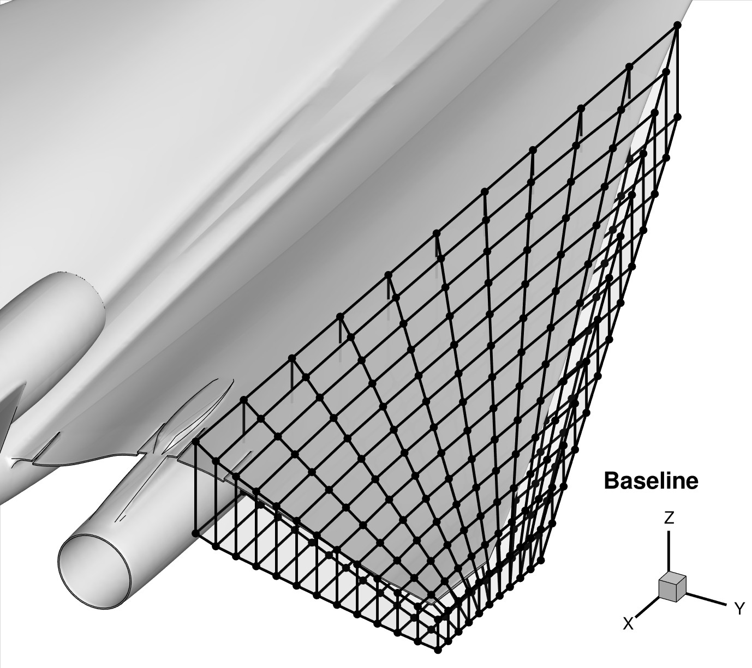
Baseline (LM-1021) geometry and design variables

Slide 27
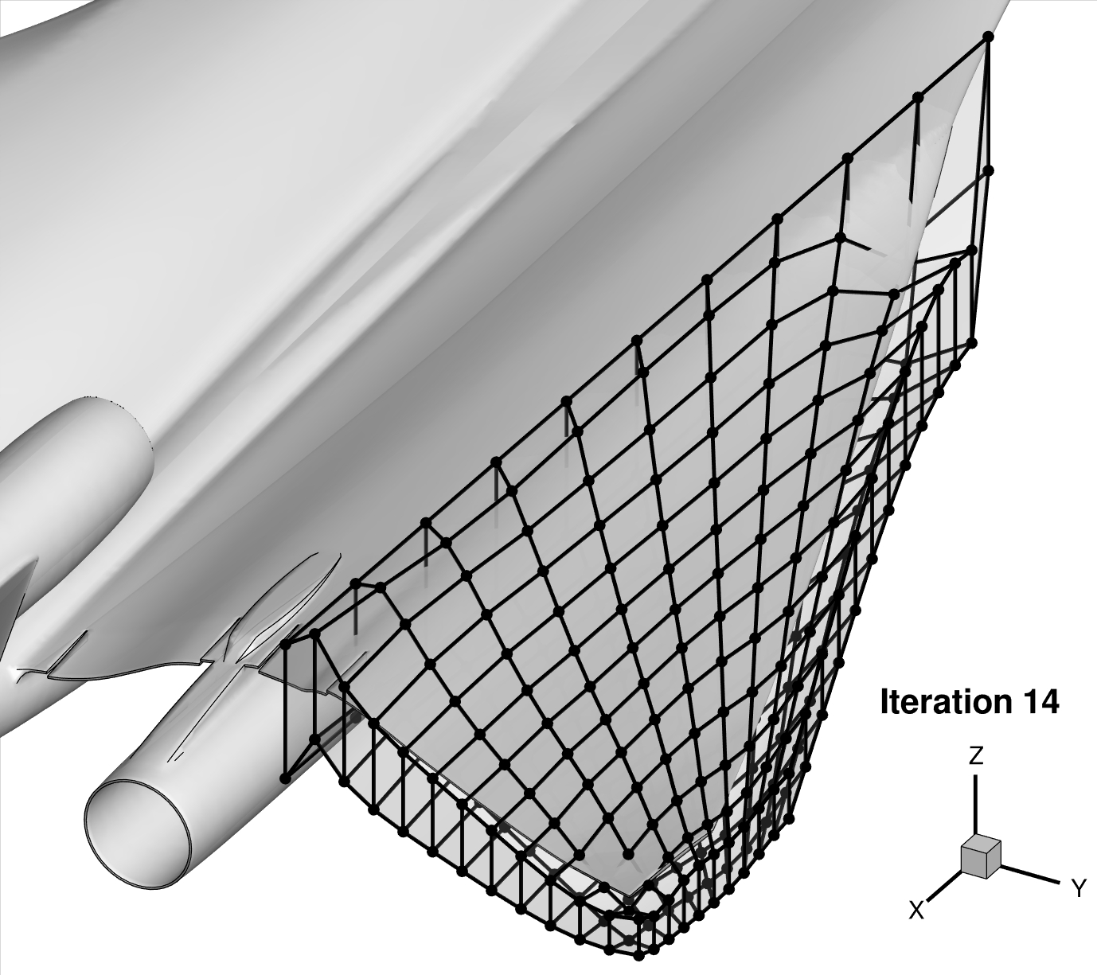
Optimized (iteration 14) geometry and control points loc.

Slide 28
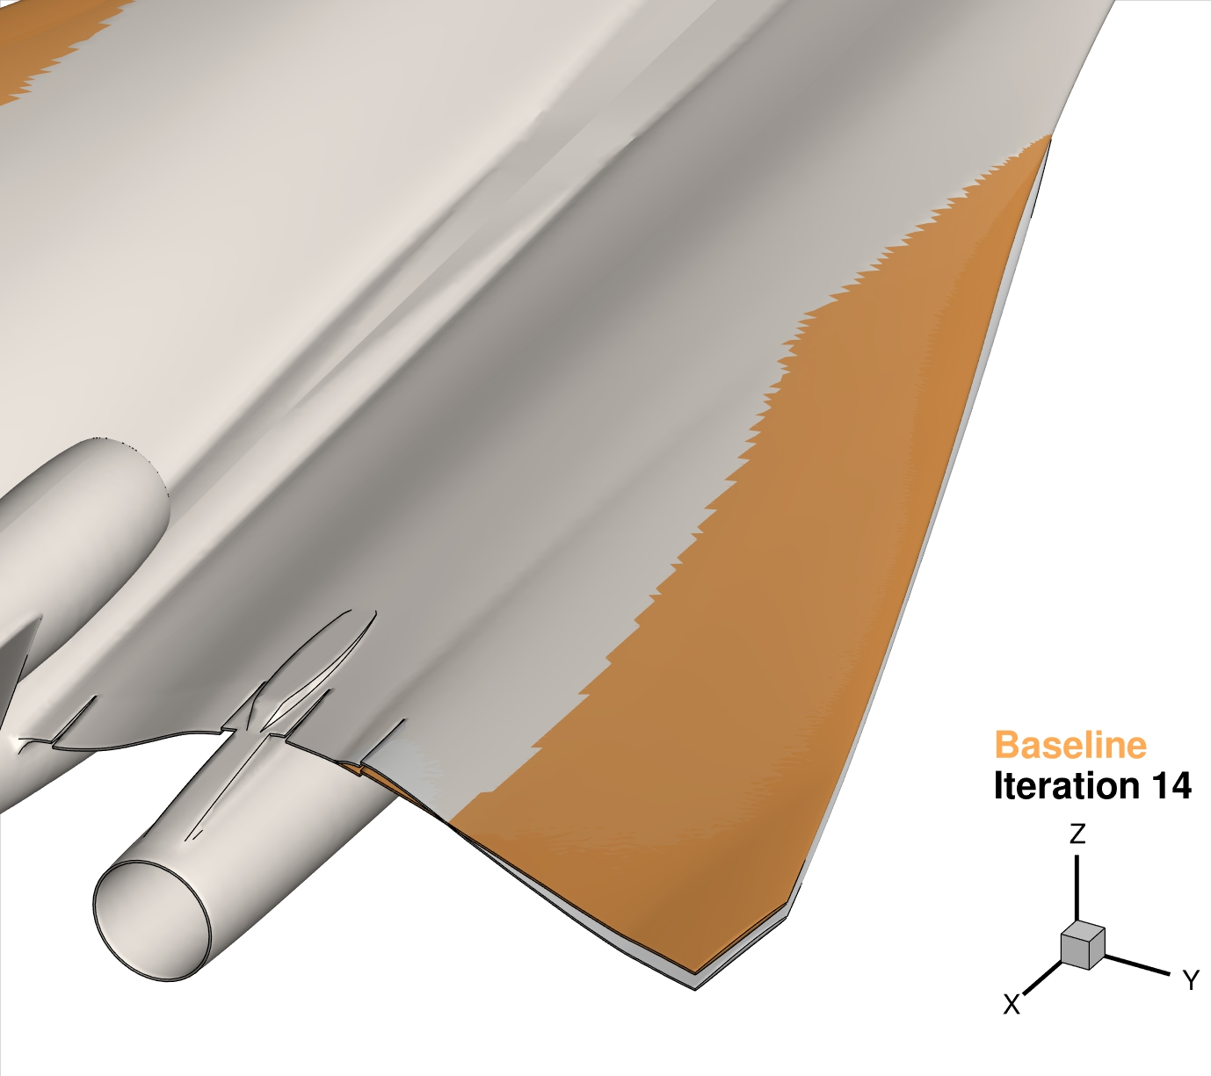
Geometry comparison
Oops… this is not OK
Let’s fix it!

Slide 29
Introduction to Shape design
1st Optimization Attempt
2nd Optimization Attempt
Conclusions

Slide 30
Redefine the Optimization Problem
We should redefine our optimization problem.
Modify the design variables to guarantee the continuity of the 1st surface derivative.
Add new constraints: Max thickness in the inboard and outboard sections (90%) and minimum twist angle (-3.4deg)
% Optimization objective function with scaling factor
% ex= Objective * Scale
OPT_OBJECTIVE= DRAG * 0.01
%
% Optimization constraint functions with scaling factors, separated by semicolons
% ex= (Objective = Value ) * Scale, use '>','<','='
OPT_CONSTRAINT= (MOMENT_Y < 0.0135919515) * 0.01; (LIFT > 0.13212308464) * 0.01; (MAX_THICKNESS_SEC1 > 0.0035208432) * 0.01; (MAX_THICKNESS_SEC2 > 0.0027518184) * 0.01; (MAX_THICKNESS_SEC3 > 0.0020452032) * 0.01; (MAX_THICKNESS_SEC4 > 0.0013014216) * 0.01; (MAX_THICKNESS_SEC5 > 0.00052060608) * 0.01; (AOA_SEC1 > -3.3) * 0.01; (AOA_SEC2 > -3.3) * 0.01; (AOA_SEC3 > -3.3) * 0.01; (AOA_SEC4 > -3.3) * 0.01; (AOA_SEC5 > -3.3) * 0.01

Slide 31
New Geometry Parameterization
FFD box for redesigning the Lockheed Martin 1021 configuration
241 FFD Control Point Variables
DEFINITION_DV= ( 7, 1.0 | aircraft | WING, 0, 2, 0, 0.0, 0.0, 1.0 ); ( 7, 1.0 | aircraft | WING, 1, 2, 0, 0.0, 0.0, 1.0 ); ( 7, 1.0 | aircraft | WING, 2, 2, 0, 0.0, 0.0, 1.0 ); ( 7, 1.0 | aircraft | WING, 3, 2, 0, 0.0, 0.0, 1.0 ); ( 7, 1.0 | aircraft | WING, 4, 2, 0, 0.0, 0.0, 1.0 ); ( 7, 1.0 | aircraft | WING, 5, 2, 0, 0.0, 0.0, 1.0 ); ( 7, 1.0 | aircraft | WING, 6, 2, 0, 0.0, 0.0, 1.0 ); ( 7, 1.0 | aircraft | WING, 7, 2, 0, 0.0, 0.0, 1.0 ); ...

Slide 32
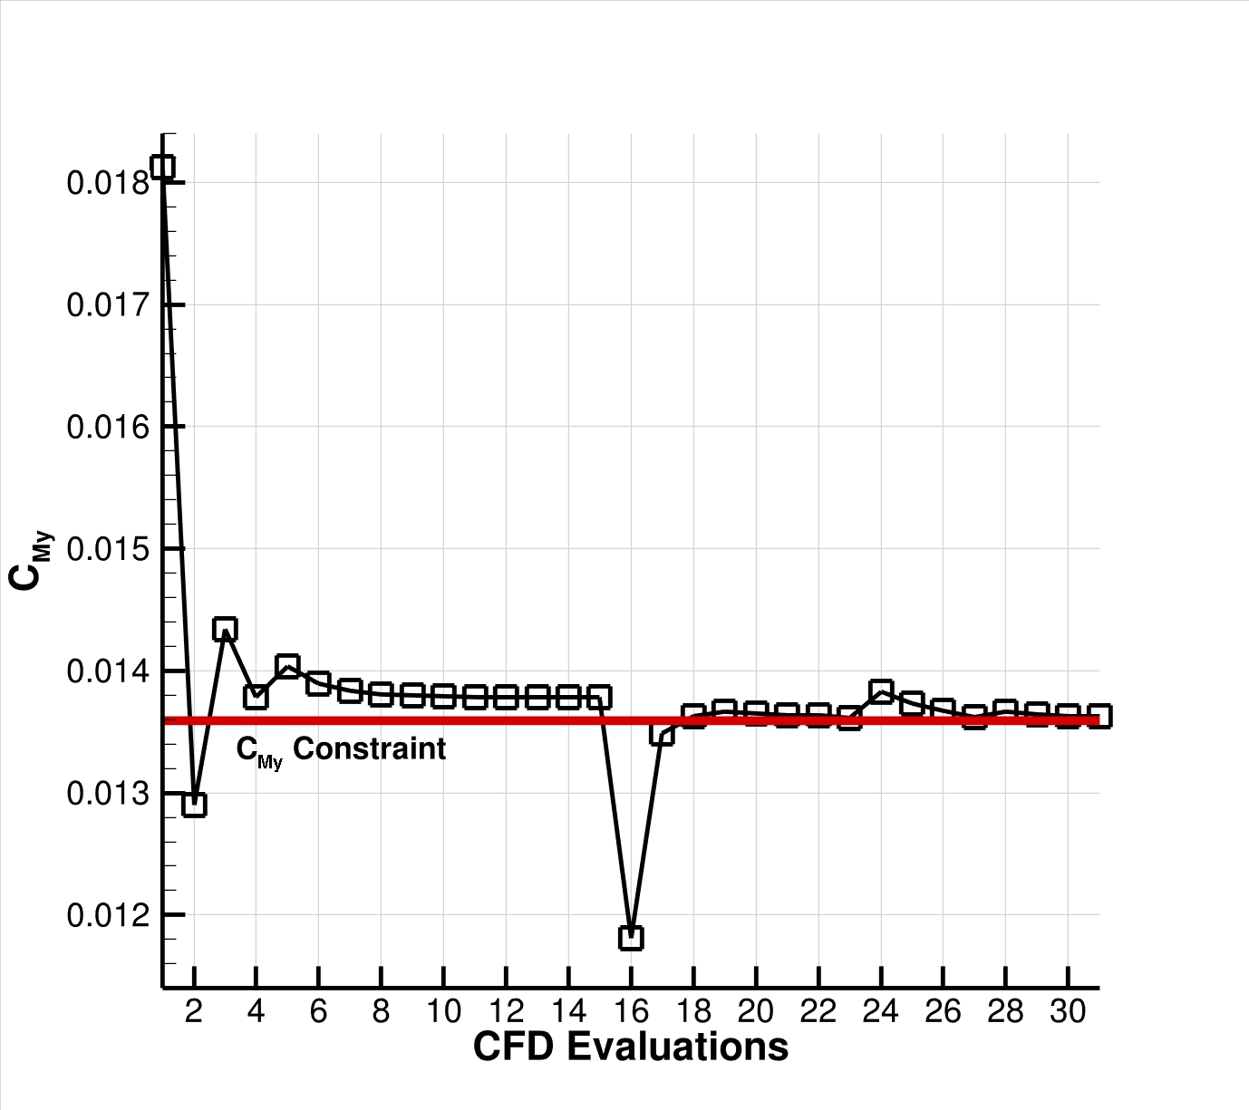
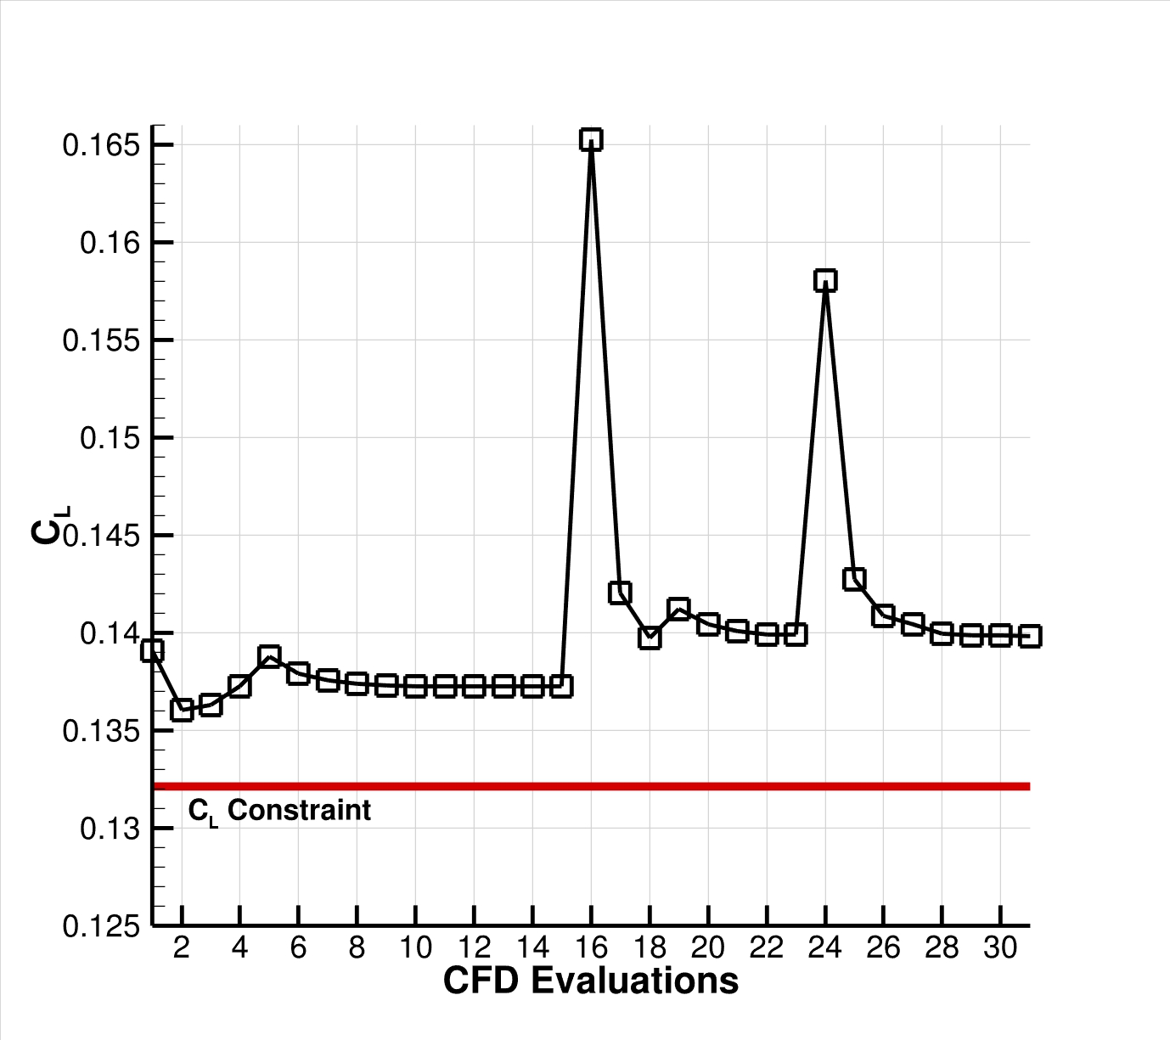
Lift and Pitching Moment Constraint
Objective: Reduce C_{My} from 0.018 to 0.0135.
Maintaining C_{L} (with a minimal impact in C_{D}).
Constraining the minimum value of the maximum thickness and twist angle at 4 sections.
Using 241 design variables.
✔
✔

Slide 33
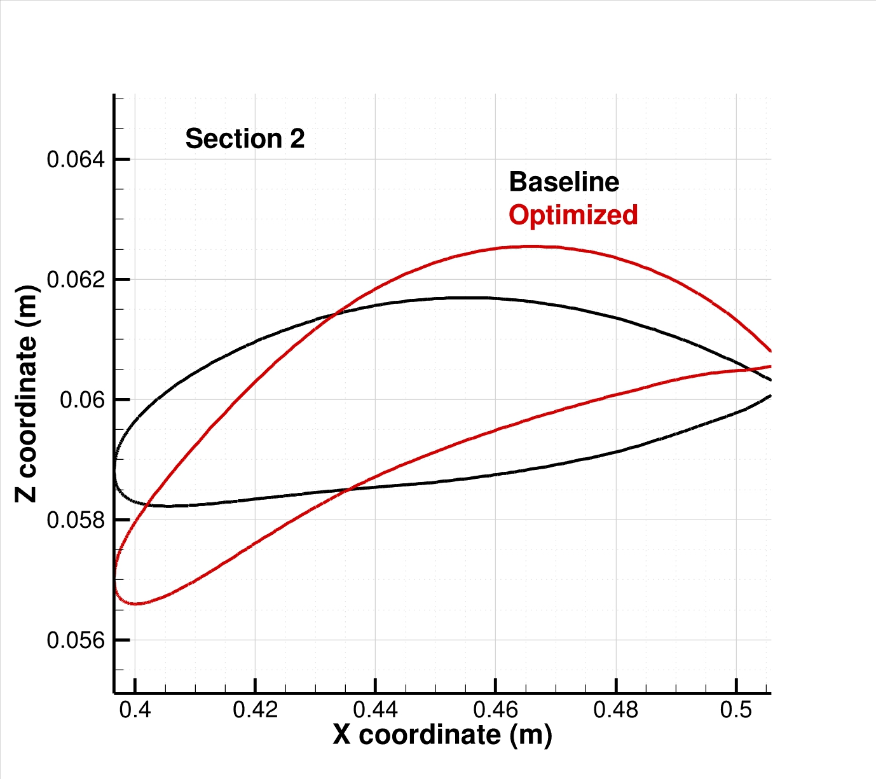
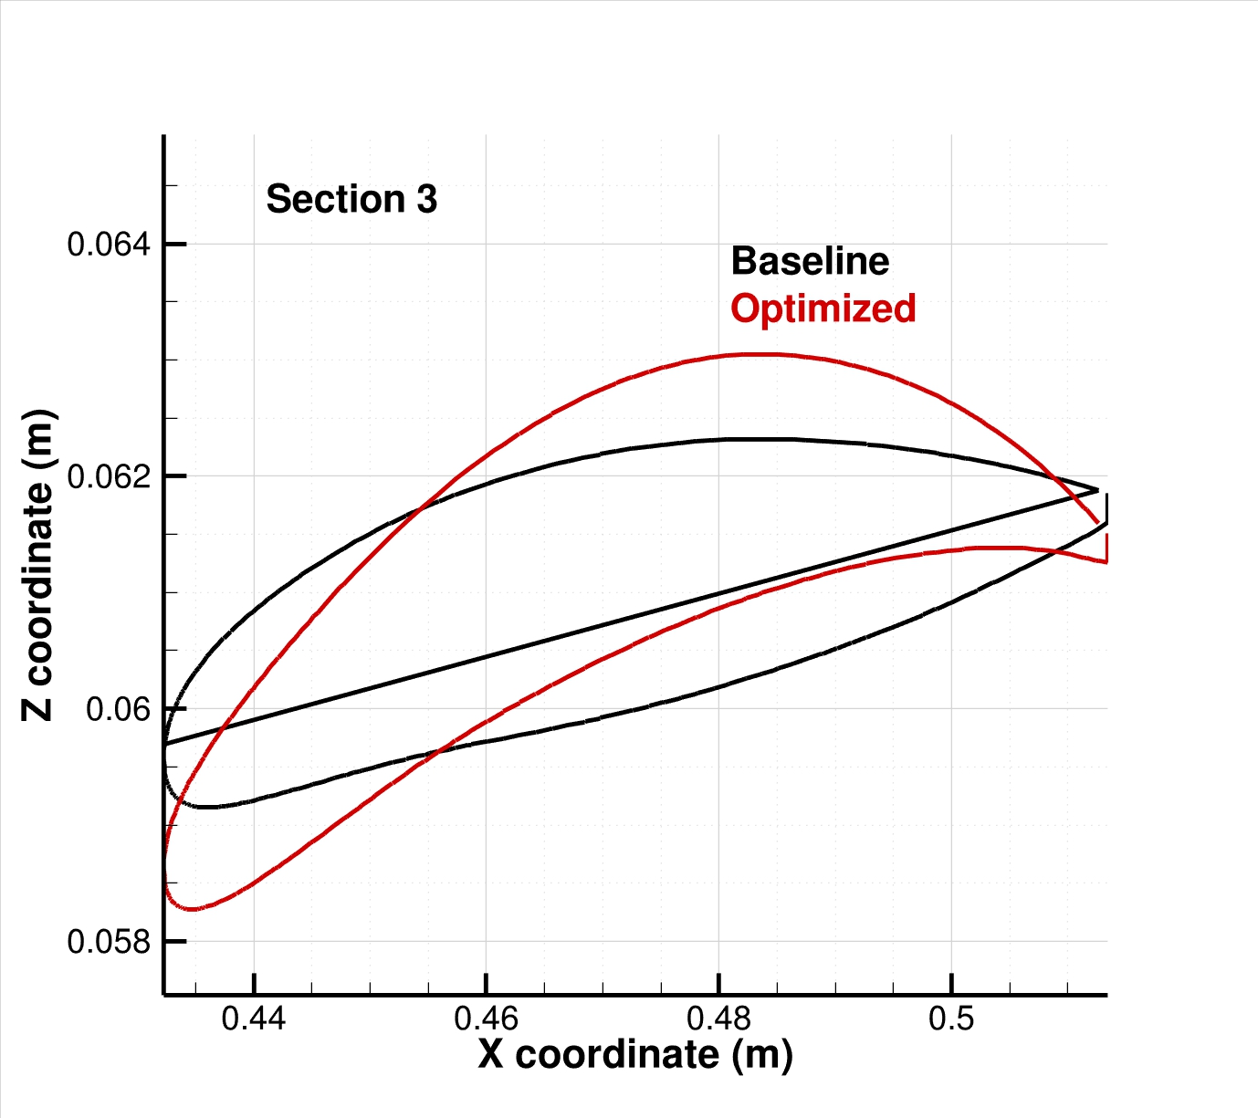
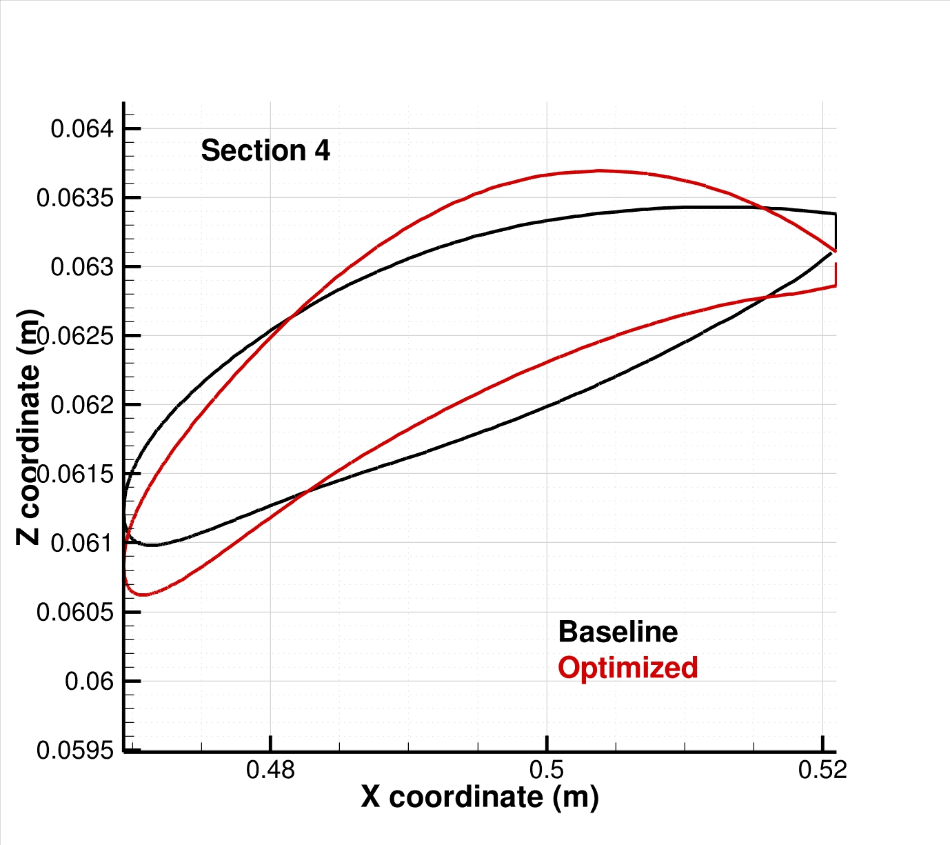
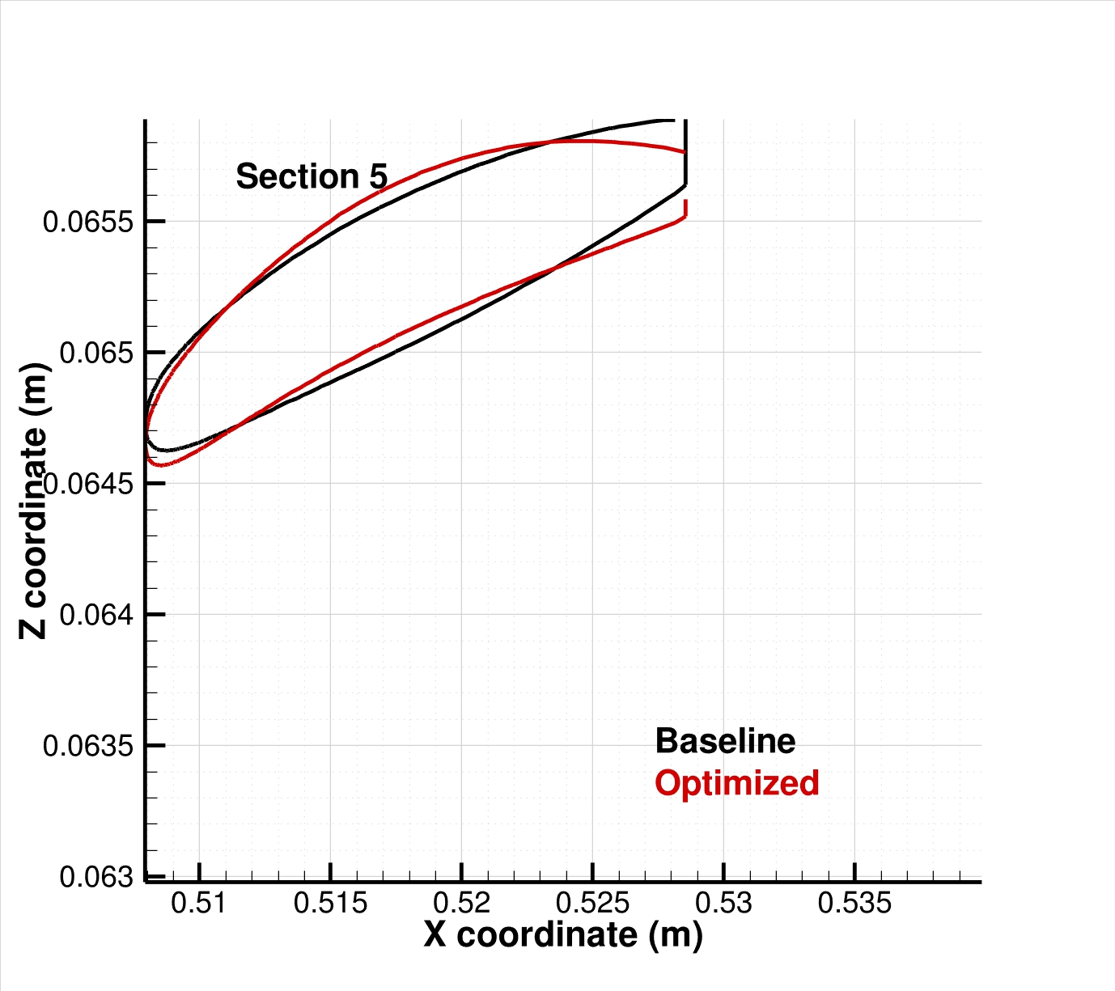
Geometric constraints

Slide 34
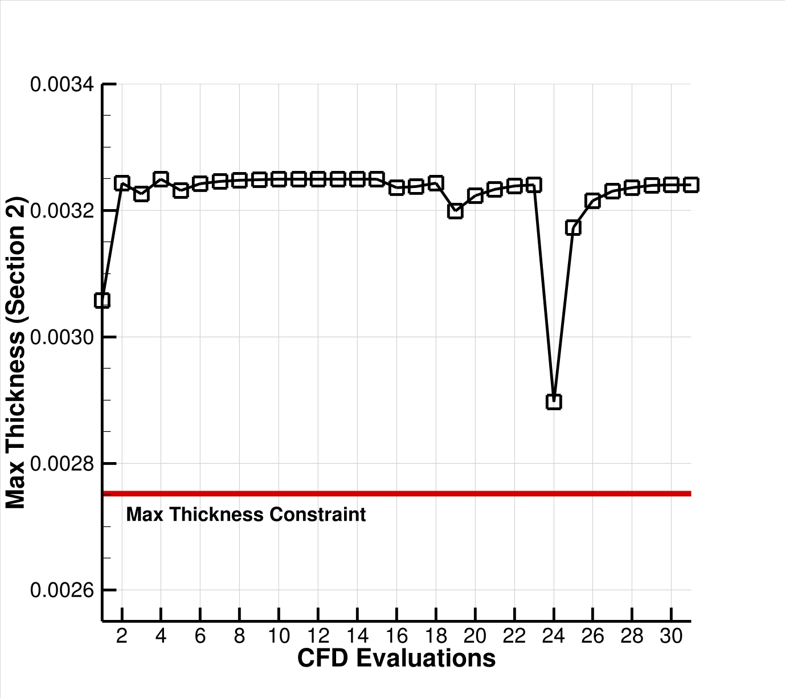
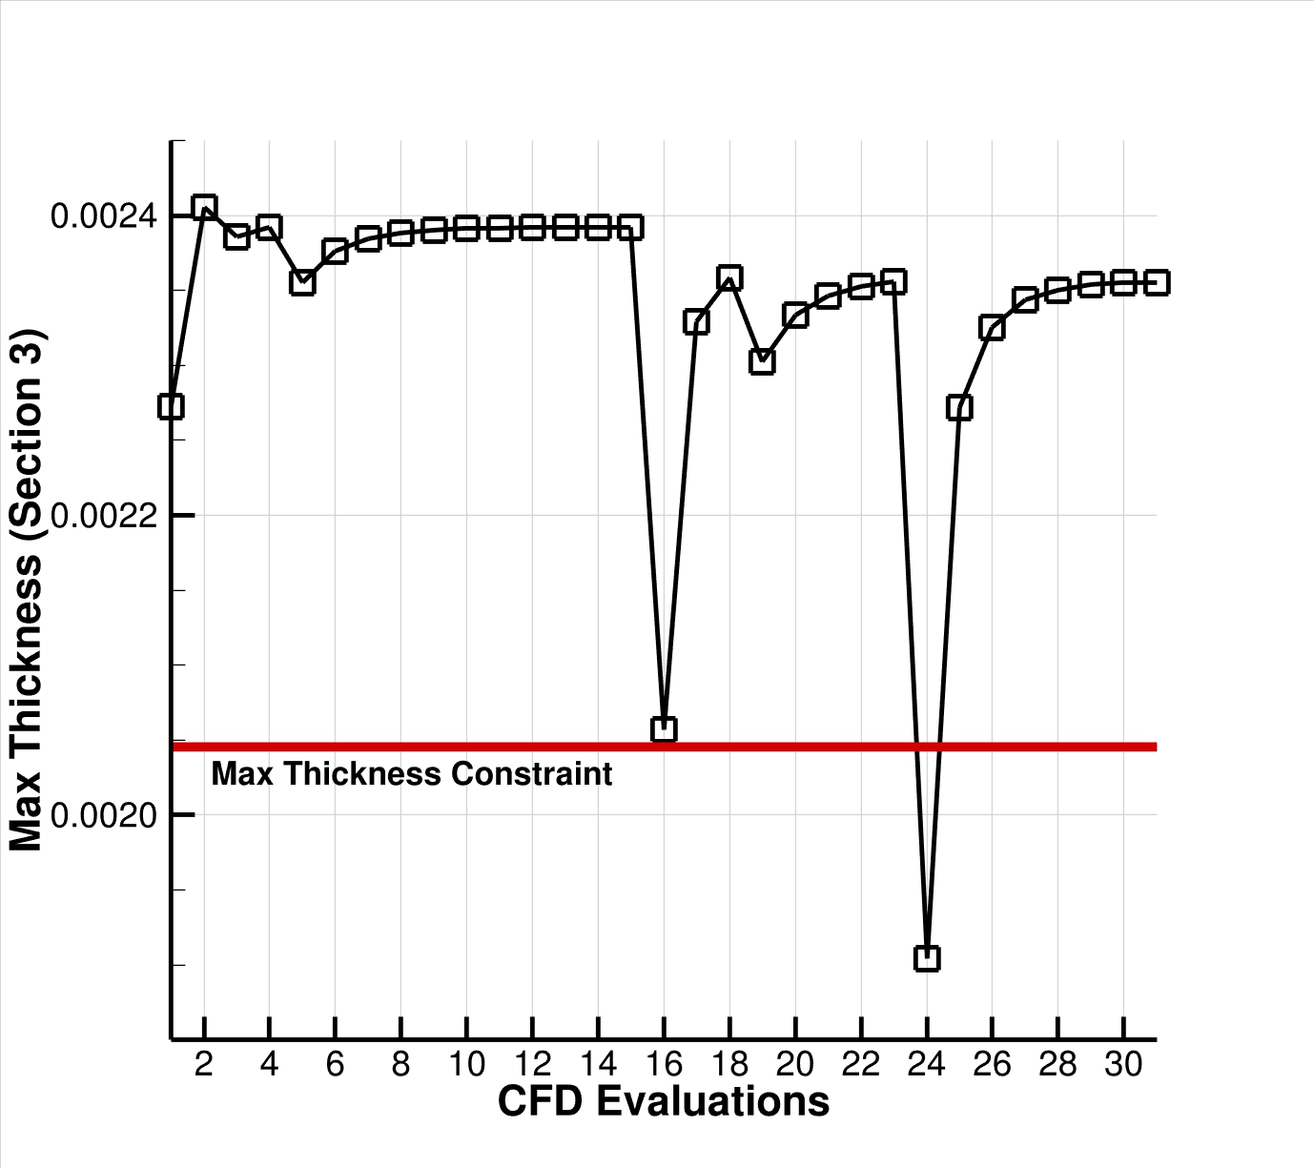
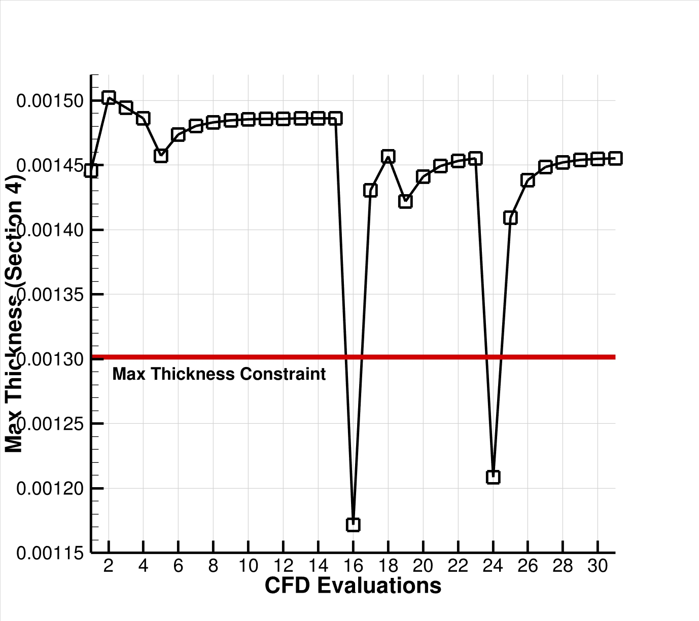
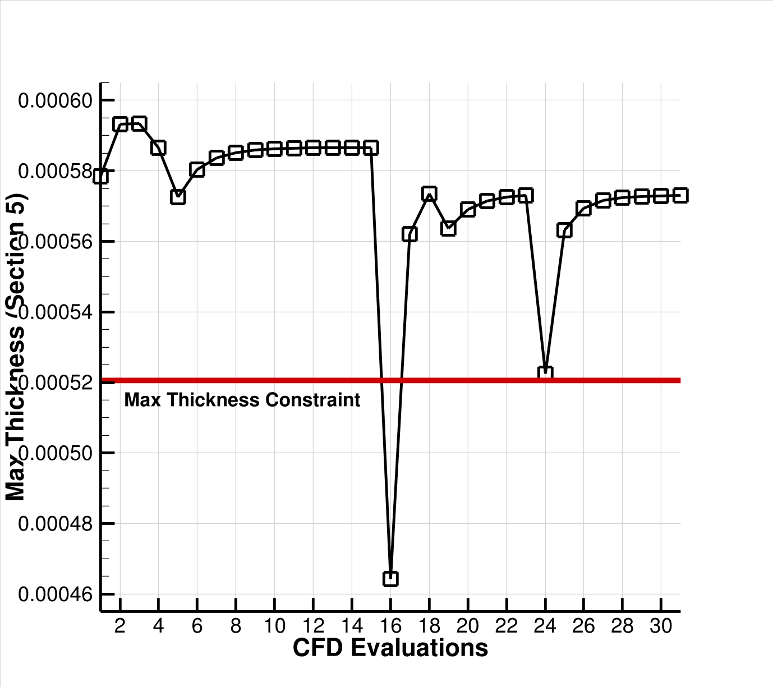
Maximum thickness constraint

Slide 35
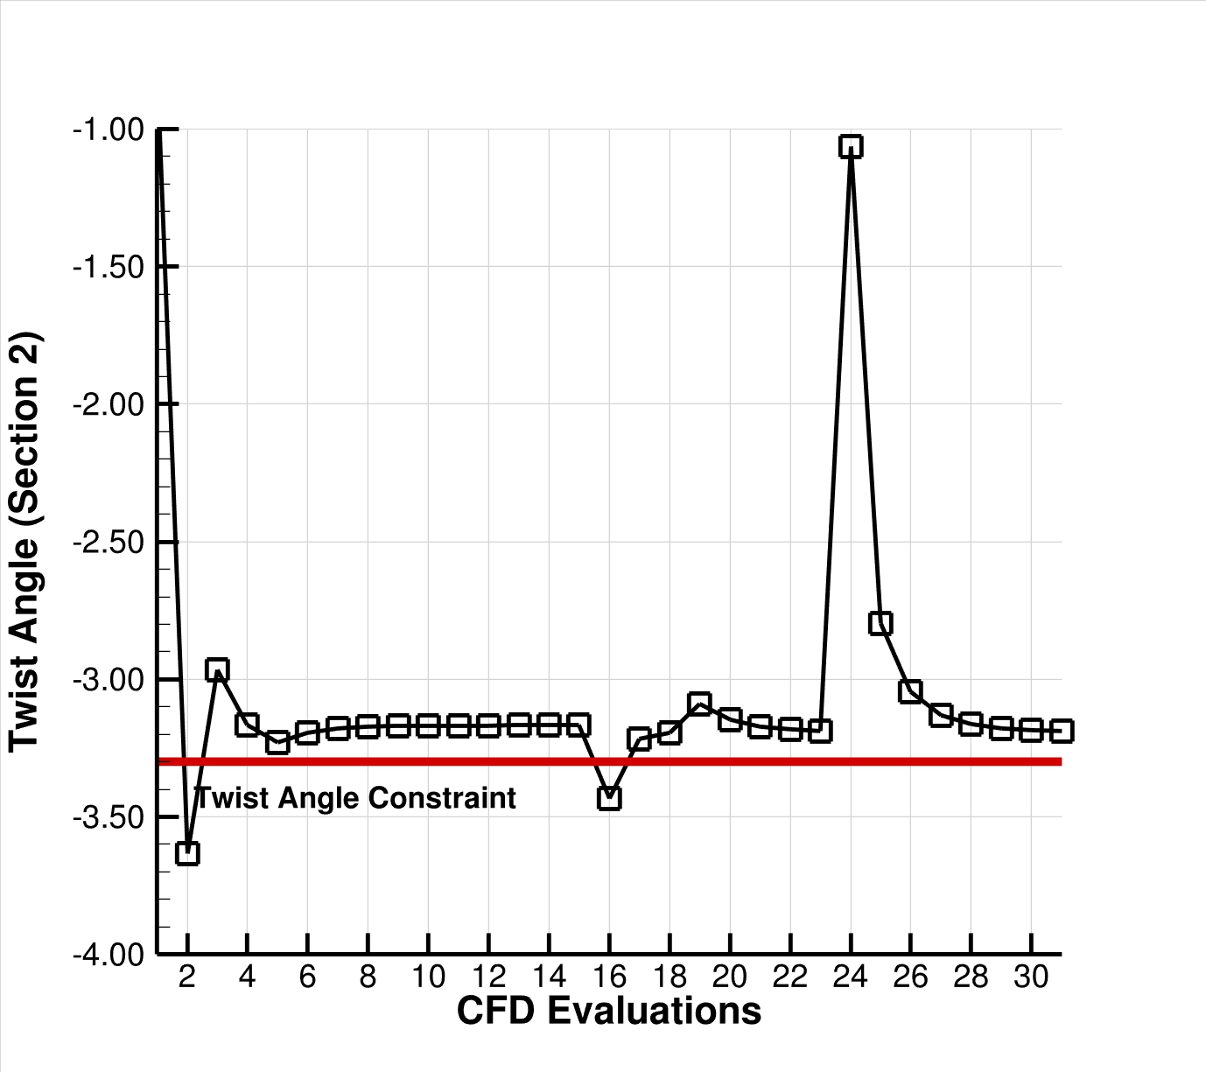
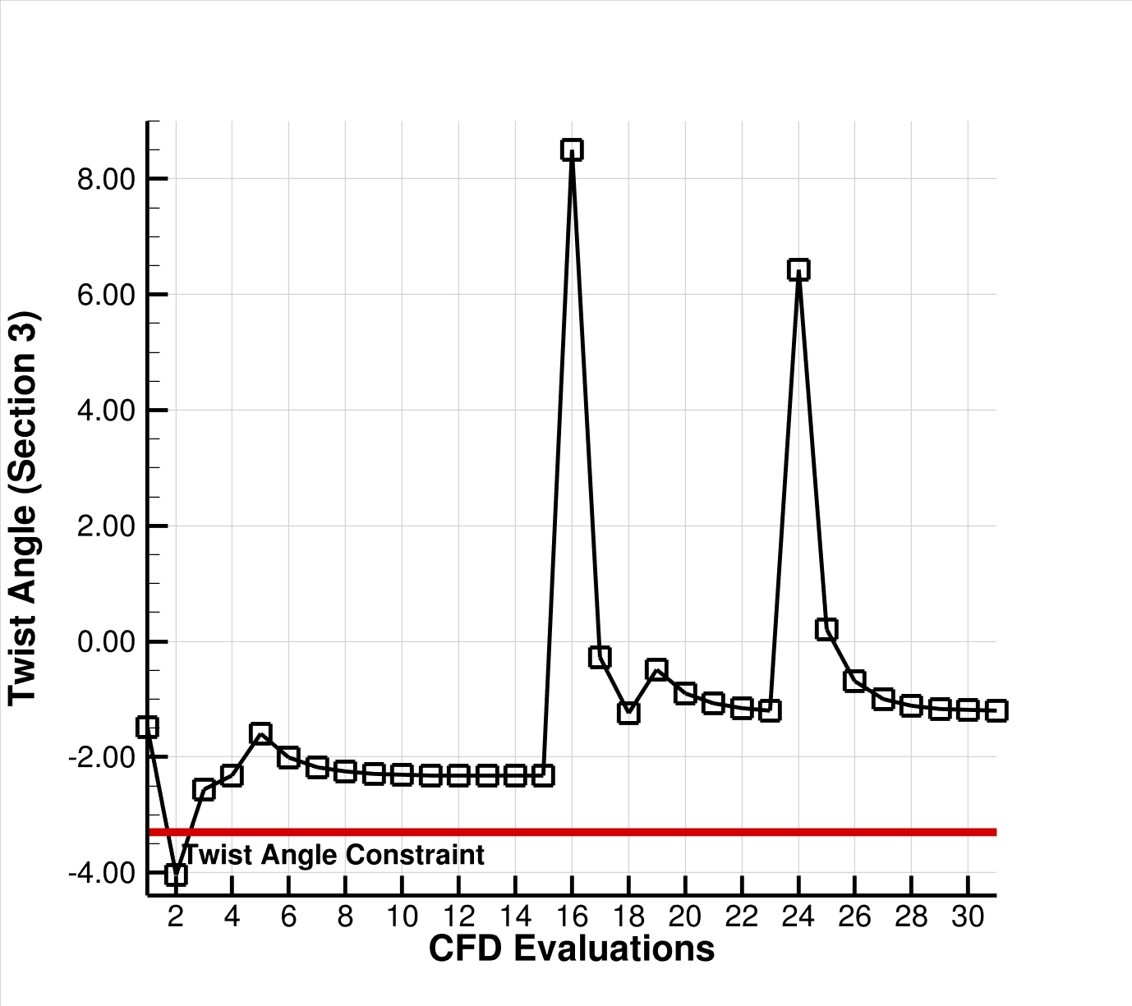
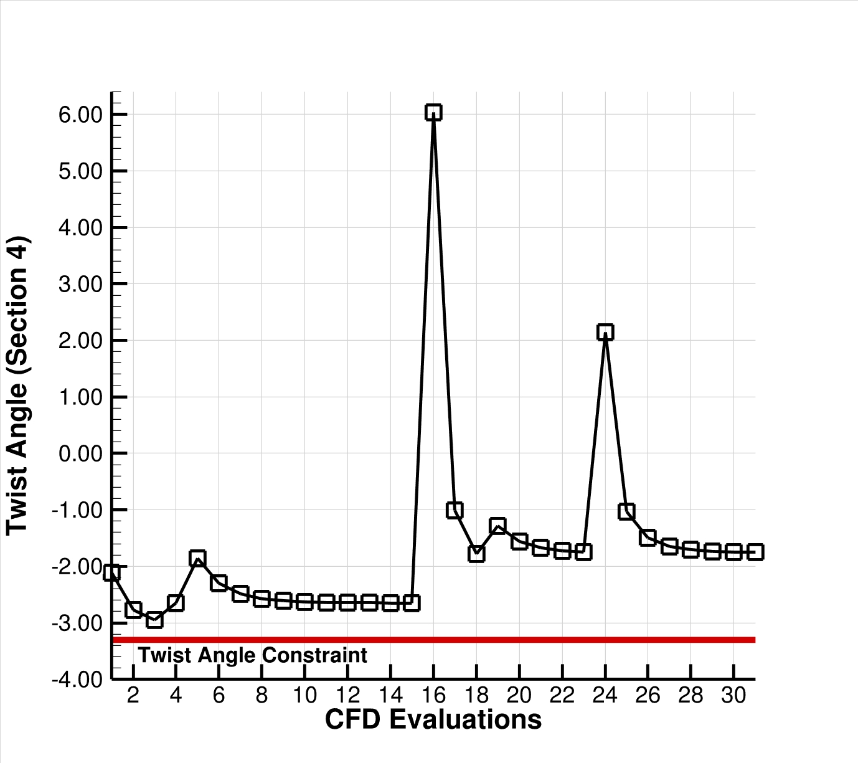
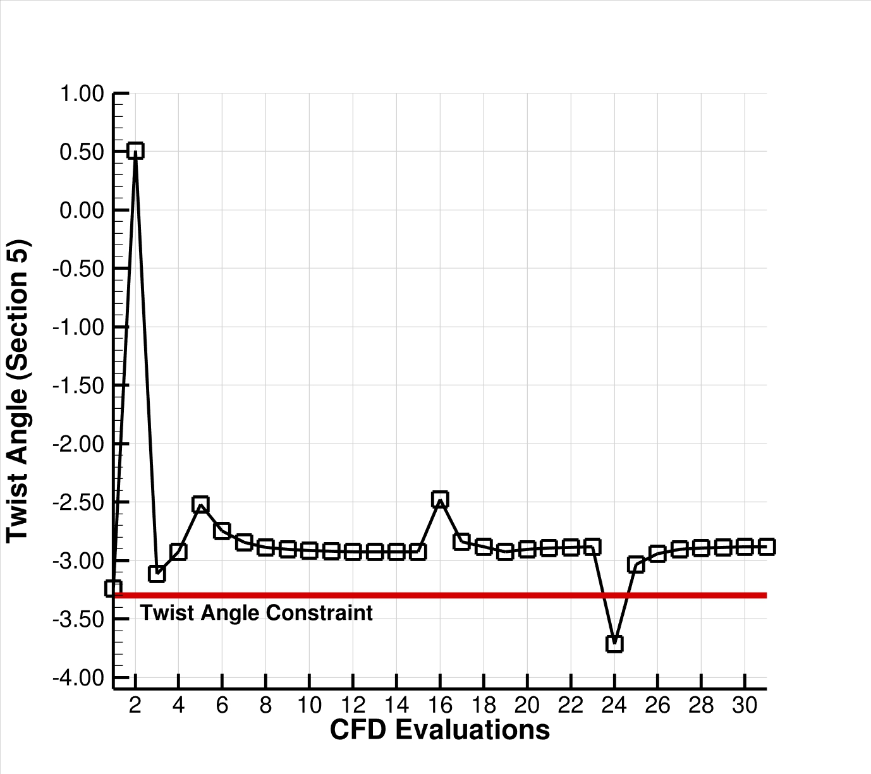
Twist angle constraint

Slide 36
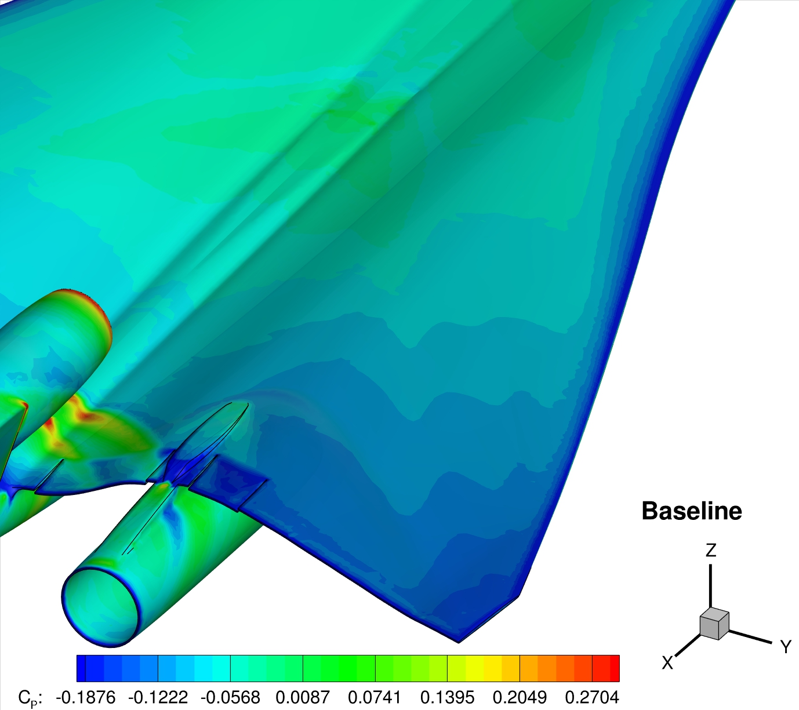
Baseline configuration. C_{p} distribution

Slide 37
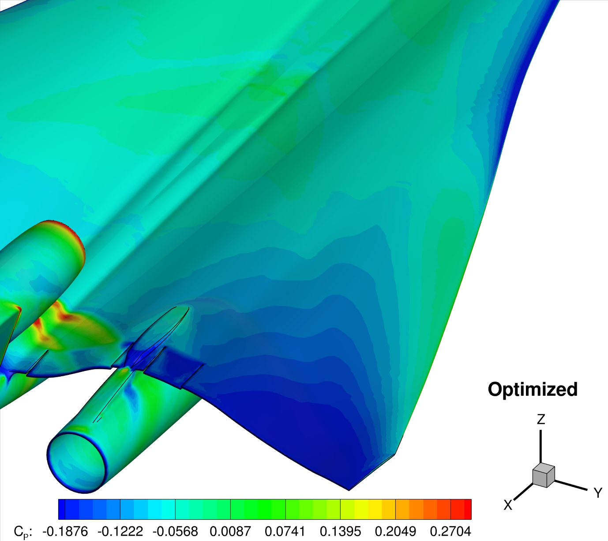
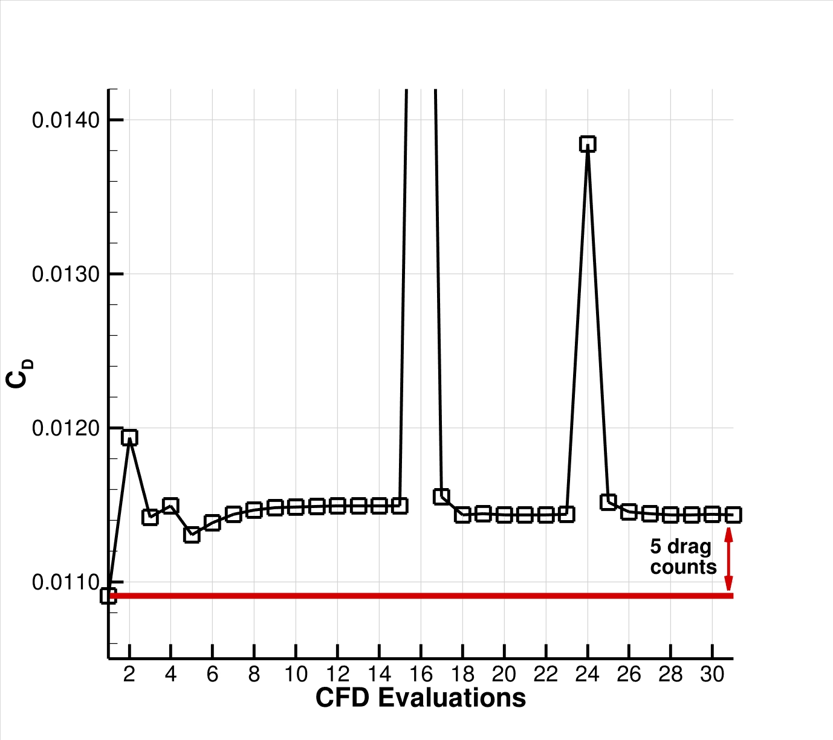
Optimized configuration. C_{p} distribution

Slide 38
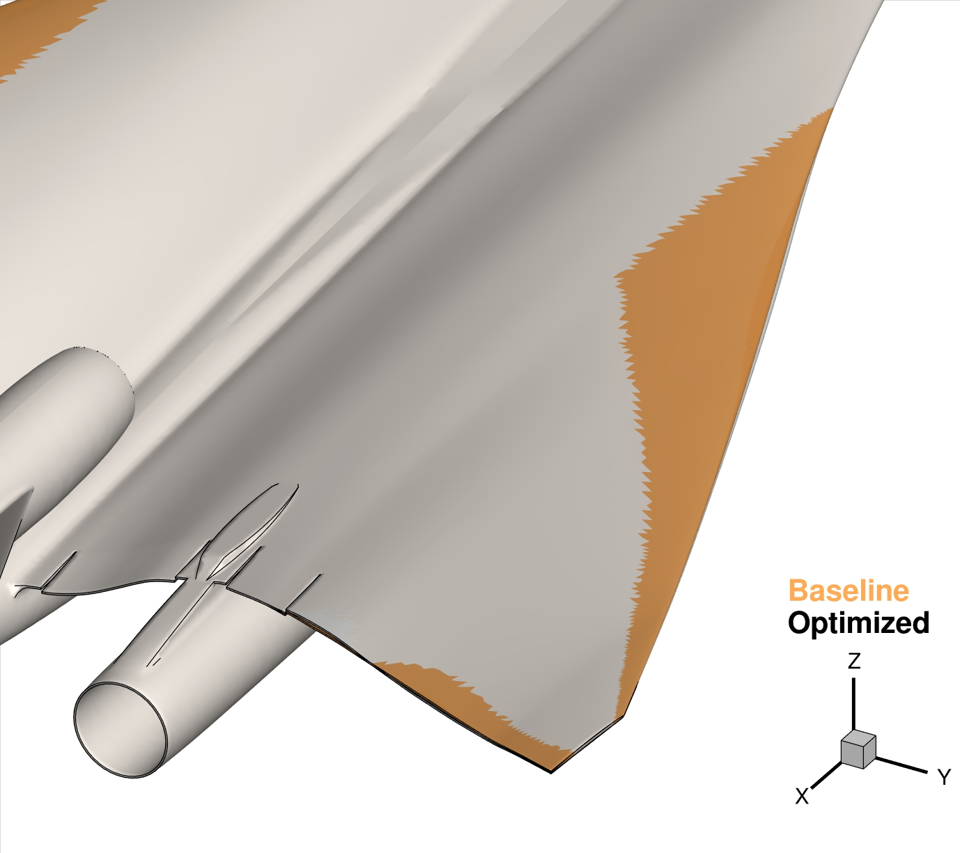
Geometry comparison

Slide 39
Introduction to Shape design
1st Optimization Attempt
2nd Optimization Attempt
Conclusions

Slide 40
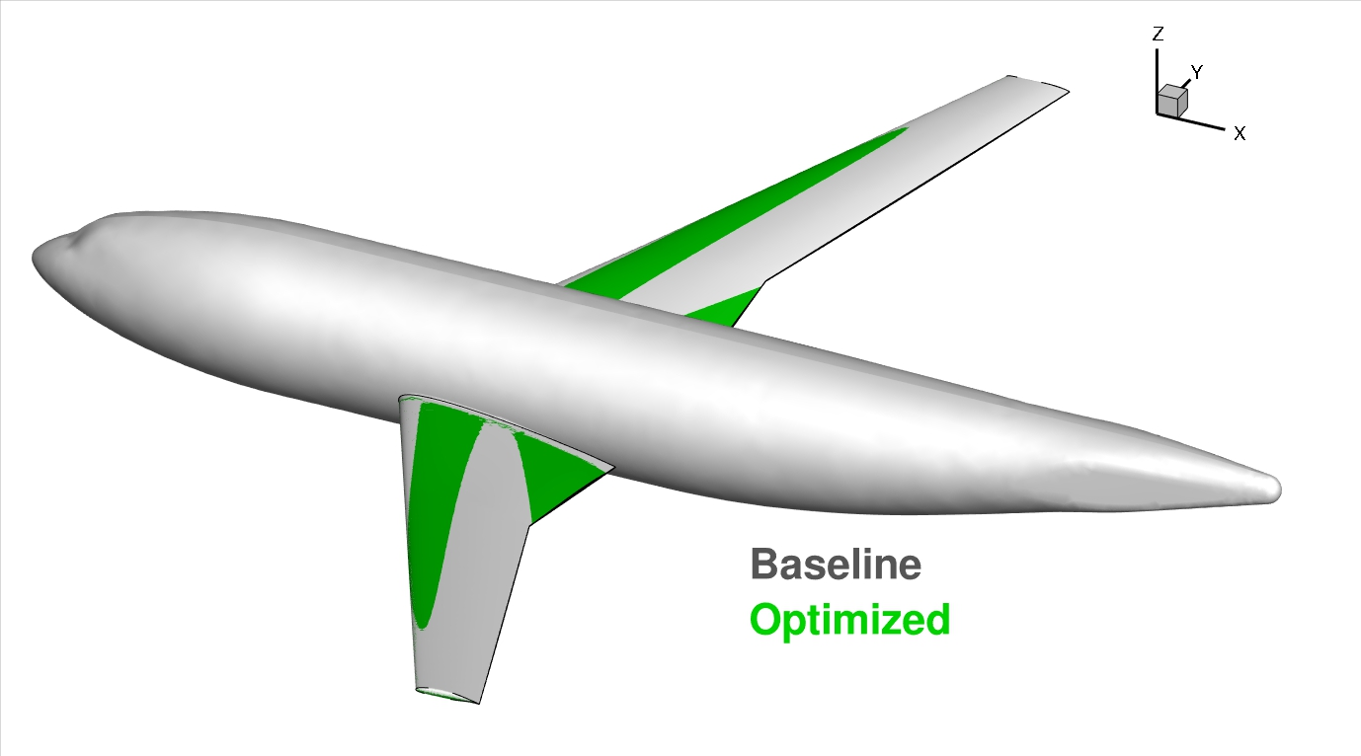
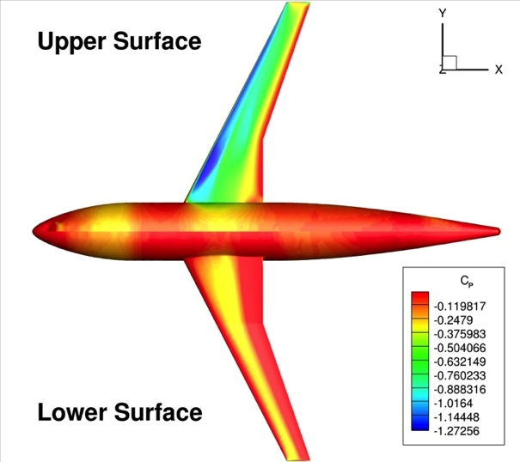
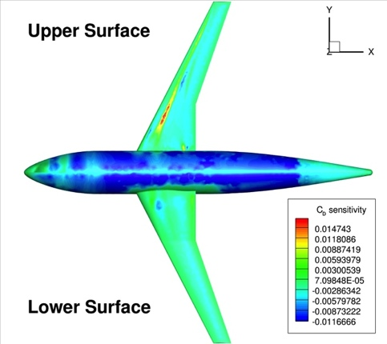
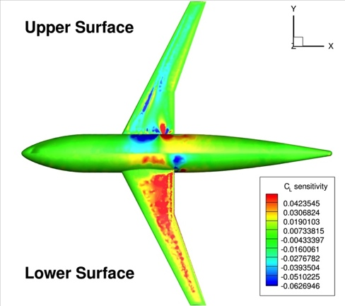
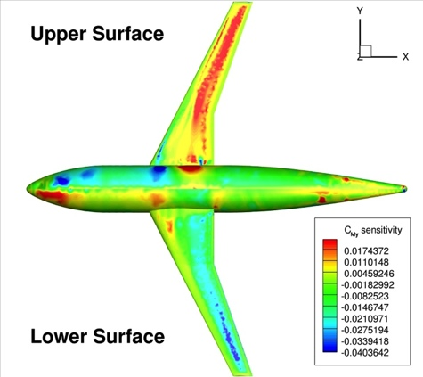
RANS optimization
RANS optimization
5% less C_{D} with the same C_{L}

Slide 41
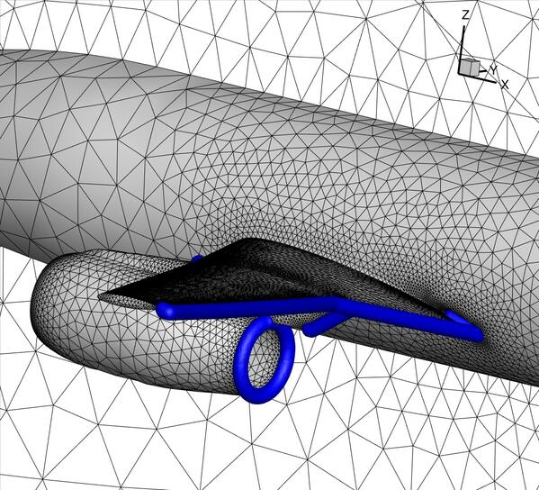
We’ve Only Scratched the Surface…
Objective Functions and Constraints:
Drag, lift, moments.
Stability derivatives.
Load distribution on the wing.
Free-surface problems.
Near-field pressure.
Equivalent area distribution.
Multiple geometrical constraints using unstructured grids.
Compressible and incompressible.
Euler and RANS problems.
Steady and unsteady applications.
Exclusive numerical schemes designed to solve the adjoint equations.
Once a design is finalized, SU2_MDC can export .stl files of the geometry to reintegrate with CAD/manufacturing

Slide 42
Thanks a lot for your attention!
Questions & Answers

